Slide 1
Angular JS - Workshop
by Rohit Saidugari & Gunashekar Koppula

Slide 2
Agenda
Introduction to Angular JS.
Advantages of Angular JS.
App
Directives.
Controllers.
Routing.
Factory.
Custom Directives.

Slide 3
What is Angular JS?
Angular JS is an open source JavaScript framework.
Developed and maintained by Google.
It is based on Microsoft’s Typescript.
Mainly used to build single page applications
Angular brings traditionally server-side services, such as view-dependent controllers, to client-side web applications. Consequently, much of the burden on the server can be reduced.

Slide 4
Why Angular JS?
Addresses the challenges encountered in developing single page applications.
Can have easy DOM manipulations using directives.
Dependency injection.
Supports two way data binding.
Testing .
Very easy to develop MVC components.

Slide 5
Get Started With Angular
Download AngularJS from https://angularjs.org/
(or)
Use the CDN link : <script src="https://ajax.googleapis.com/ajax/libs/angularjs/1.6.9/angular.min.js"></script>
Setup IntelliSense on VS code using
npm install -g --save-dev @types/angular
Npm install –g static-server & Static –p “portnumber”
Include ng-app attribute in html code.

Slide 6
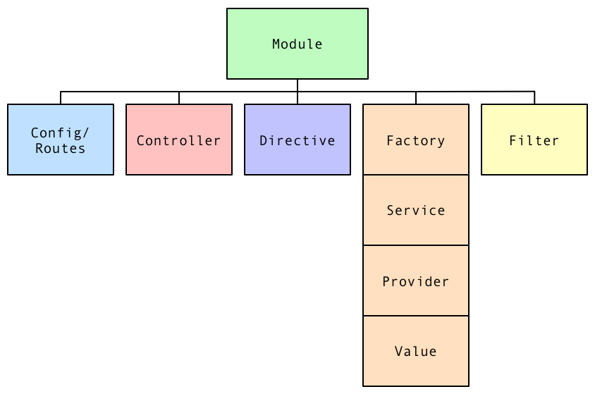
Angular JS Conceptual Structure

Slide 7
Module
A module is a container for different parts of application i.e. controllers , services, directives ,filters.
You can think of a module as a main() method in other types of application.
How to create a Module ?
use the angular objects module method to create a
module.
let app = angular.module("myApp", []);

Slide 8
Directives
In Angular a directive are extended html attributes with prefix ng.
Used to add functionality to html pages
There are 2 types of directives . Built-in Directives, custom directives.
ng-app directive initializes an AngularJS application.
ng-model directive binds the value of HTML controls (input, select, text area) to application data.
ng-controller directive attaches a controller class to the view.
Learn more at https://code.angularjs.org/1.7.8/docs/api/ng/directive.

Slide 9
Controller
In Angular Controller is a JavaScript function.
The job of the controller is to build model for a view.
How to create a controller?
let myController= function($scope){
$scope.message= “Hey !!! This is AngularJS”;
}

Slide 10
Registering a controller with a module
Create a module.
Create a controller.
Use controller method to register a controller.
myApp.controller("MyController",function($scope){
$scope.message= "Hi This is angular";
});
In Views ,use scope variables created in controller method.

Slide 11
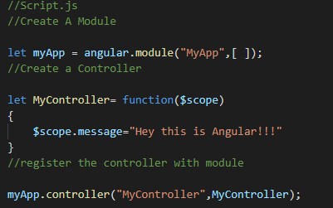
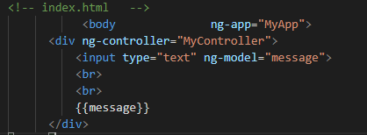
Registering a controller with a module

Slide 12
Two - Way Data binding
Keeps the model and view in sync.
ng-model directive is used to bind the data to model.

Slide 13
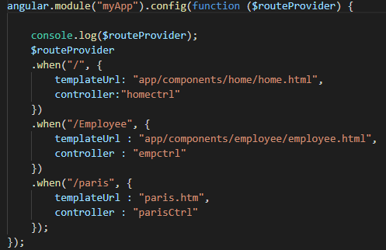
Routing
The routing is done in angular JS using the ng route module.
Include angular-route in your html https://code.angularjs.org/1.7.8/angular-route.min.js.
Create routes.js and include it in your html
Add ngRoute dependency to your module.

Slide 14
Implementing Routing in single page application
Fork Repository https://github.com/GunashekarKoppula/angular_sample_app.

Slide 15
How to invoke APIs
In Angular JS factory is the most common way to create and configure a service.
We create an object and add properties to it and later we will return the same object.
In our case the properties would be the methods that call the API’s

Slide 16
Custom Directives
A Custom directive is used to extend the functionality of HTML.
We use a directive function to create a custom directive.
While using a custom directive the custom tag is replaced with the template of the directive

Slide 17
References
A Conceptual Introduction to AngularJS
https://angular.io/.

Slide 18
Any Questions?

Slide 19
Thank you!!!!

